Slide 1
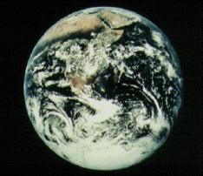
Signs of Climate Change in Erie
and Around the World
Rick Diz, Ph.D., PE
Professor Emeritus
Environmental Science & Engineering
Gannon University, Erie, PA

Slide 2
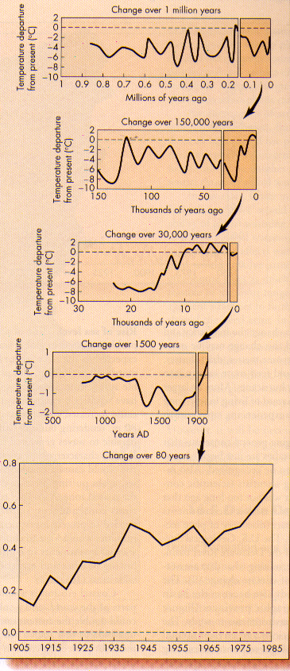
Earth’s temperature has changed continuously

Slide 3
The last 25,000 years:

Slide 4
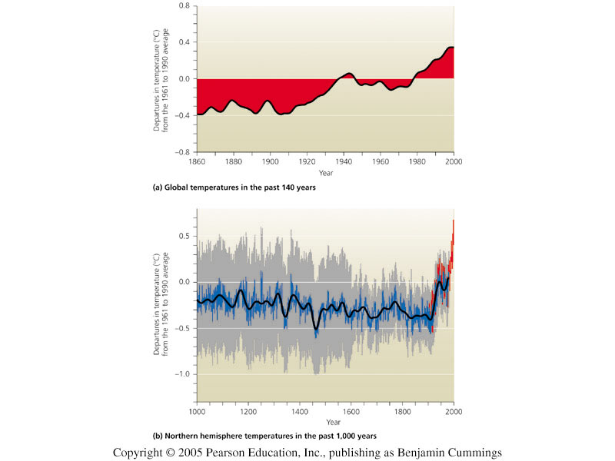
The last One Thousand Years

Slide 5
The last 150 years:

Slide 6
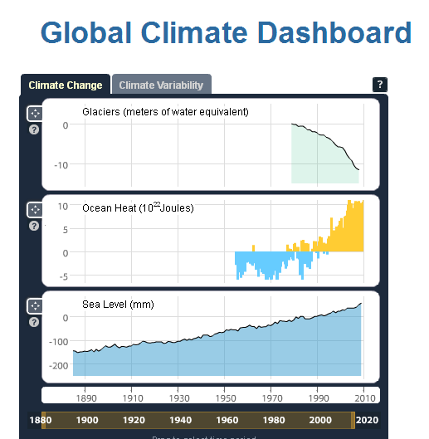
From the US NOAA website:
Glaciers are melting
Oceans are warming
Sea level is rising

Slide 7
What factors affect the Earth’s heat balance?
Amount of Energy Reaching the Earth from the Sun
Fate of that energy upon encountering the planet:
Transmission, reflection, absorption
Re-radiation
Reflectivity (albedo)
Color, texture, cloud cover
Heat Capture: the Greenhouse Effect

Slide 8
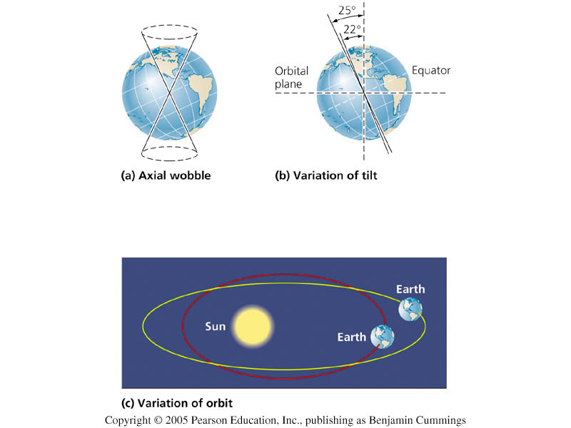
Energy From the Sun: Milankovitch cycles
These 3 types of cycles also affect climate in the long term.
Wobble of Earth’s axis
Variation of Earth’s tilt
Variation of Earth’s orbit
Even so, the amount of energy reaching
the Earth in the past 100 years has remained about constant.
Figure 12.3

Slide 9
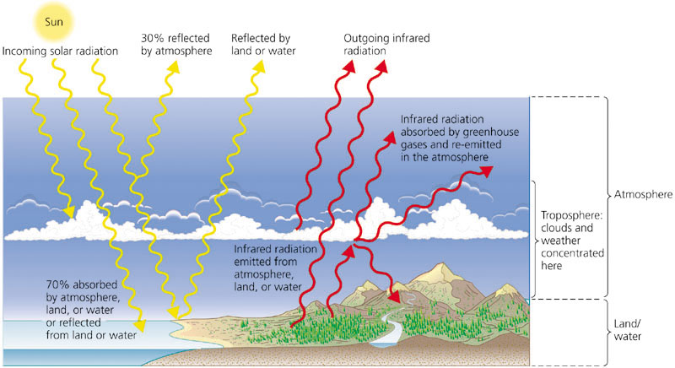
Radiation, atmosphere, and temperature
Figure 12.1

Slide 10
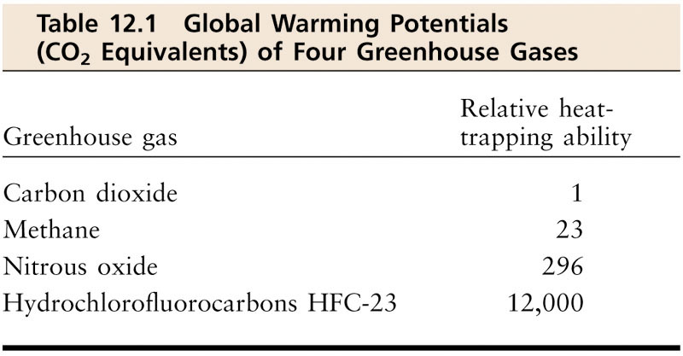
Greenhouse gases differ in ability to trap heat

Slide 11
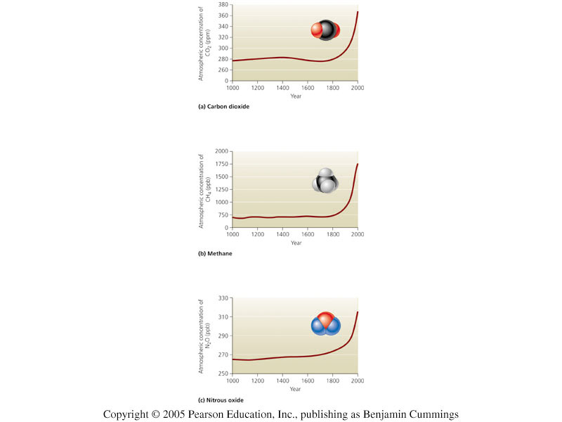
Carbon dioxide
CO₂ concentration has increased 33% in the past 200 years.
It is now at its highest level in 400,000 years, and probably 20 million years.
Figure 12.2a

Slide 12
Other greenhouse gases
Methane: up 151% since 1750.
fossil fuels, landfills, cattle, rice
Nitrous oxide: up 17% since 1750.
from feedlots, chemical plants,
auto emissions, agricultural practices

Slide 13
Aerosols
Aerosols (microscopic particles and droplets) in the atmosphere can:
warm the climate (soot), or
cool the climate (sulfates) - Sulfate-rich volcanic eruptions can cool Earth temporarily.

Slide 14
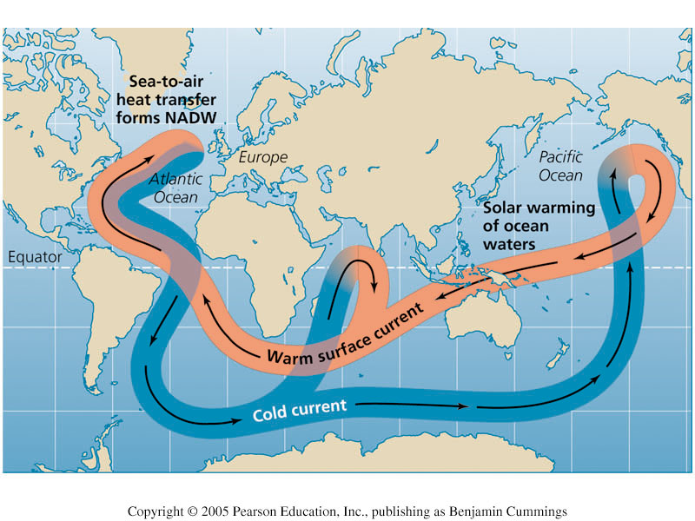
Ocean currents: the thermohaline conveyor

Slide 15
What if the Thermohaline Conveyor stops?
Melting of Greenland’s ice sheet could slow or stop the sinking of North Atlantic water.
This was the basis of the movie “The Day After Tomorrow,” which exaggerated the effect for dramatic impact.

Slide 16
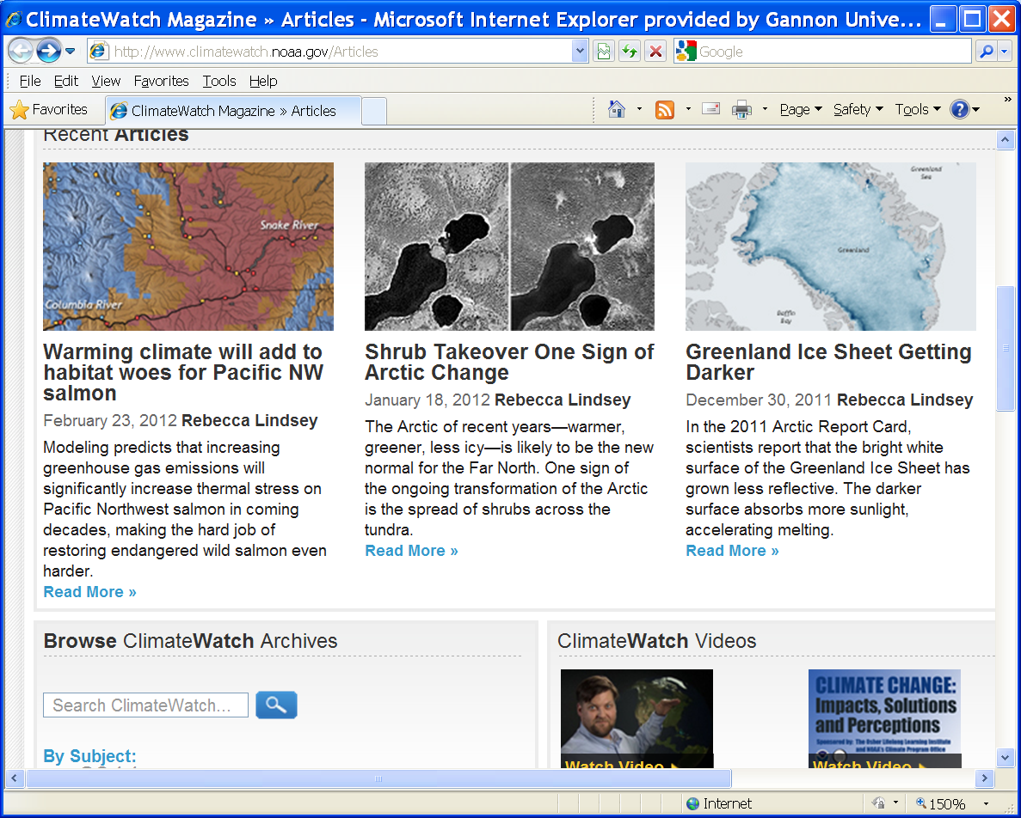
How likely is melting of the Greenland Ice Sheet?

Slide 17
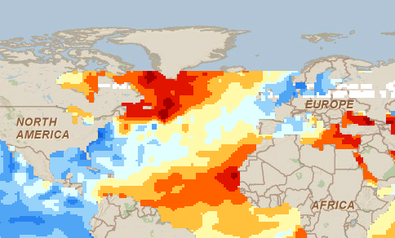
NOAA website: warmer than normal sea temperatures (Dec, 2010)

Slide 18
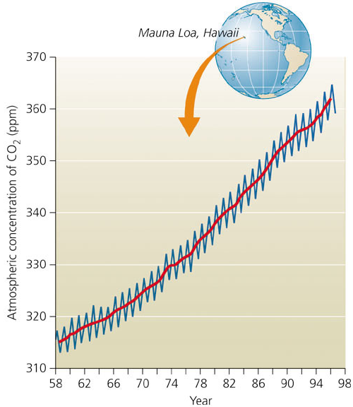
How do we know about Earth’s atmosphere and climate?
DIRECT SAMPLING:
carbon dioxide levels in the atmosphere since 1958
a steady upward climb from 315 to 373 ppm.
zigzags are winter-summer fluctuations

Slide 19
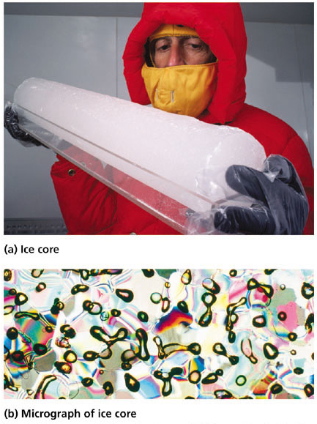
Ice cores
Ice caps and glaciers
bubbles of trapped gas
Figure 12.5

Slide 20
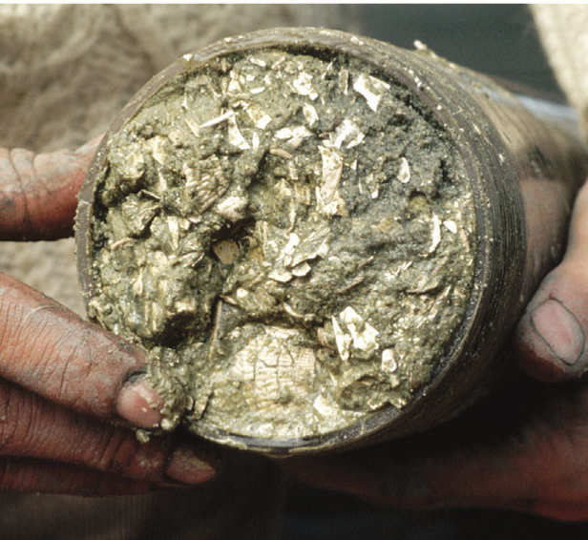
Pollen analysis
sediments of ancient lake and sea beds.
pollen grains in each layer tell what types of plants were growing at the time.
From The Science behind the Stories

Slide 21
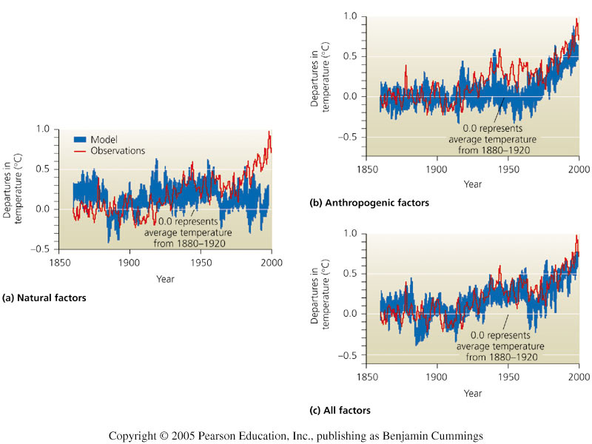
Climate Modeling
Natural or anthropogenic factors ONLY = poor fit.
BOTH types of factors = excellent fit.
Figure 12.8

Slide 22
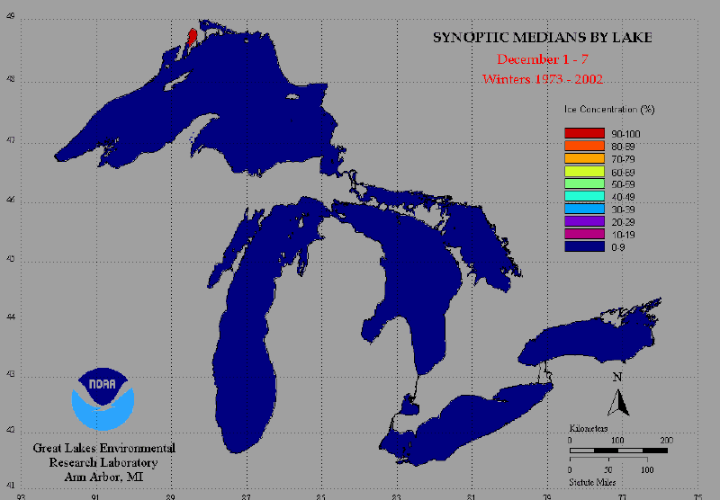
Ice Coverage During an Average Winter on the Great Lakes

Slide 23
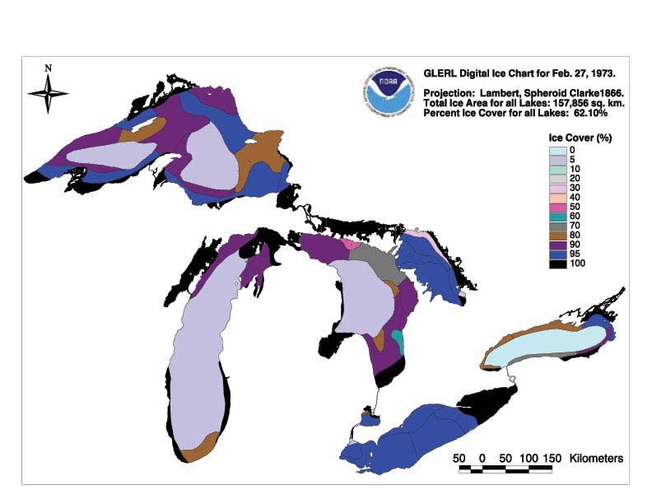
Ice Coverage of the Great Lakes last week in February: 1973

Slide 24
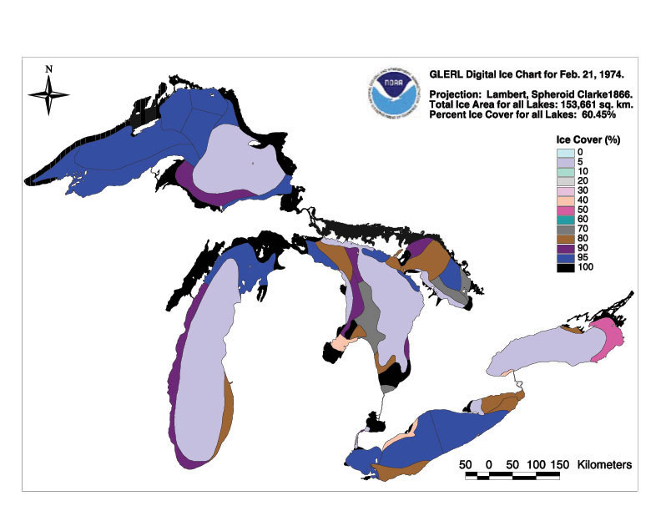
1974

Slide 25
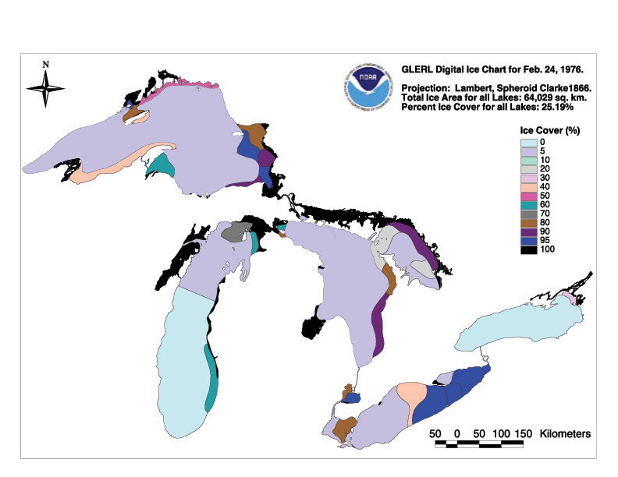
1976

Slide 26
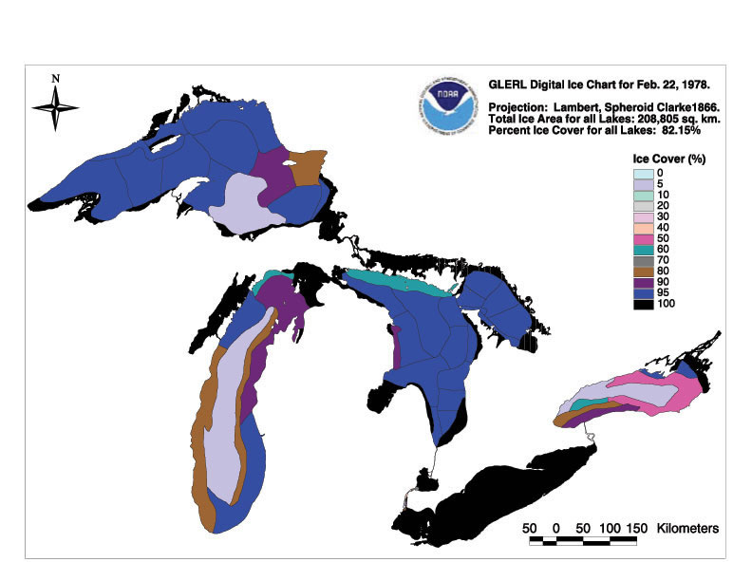
1978

Slide 27
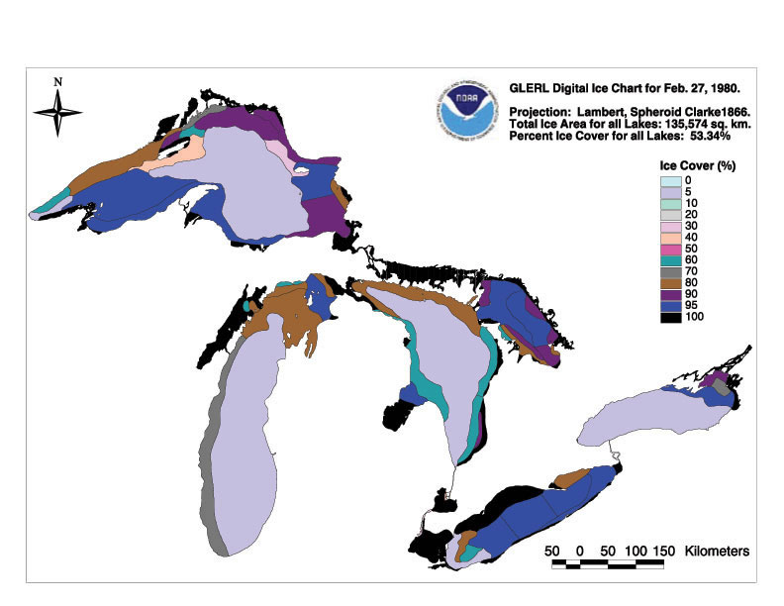
1980

Slide 28
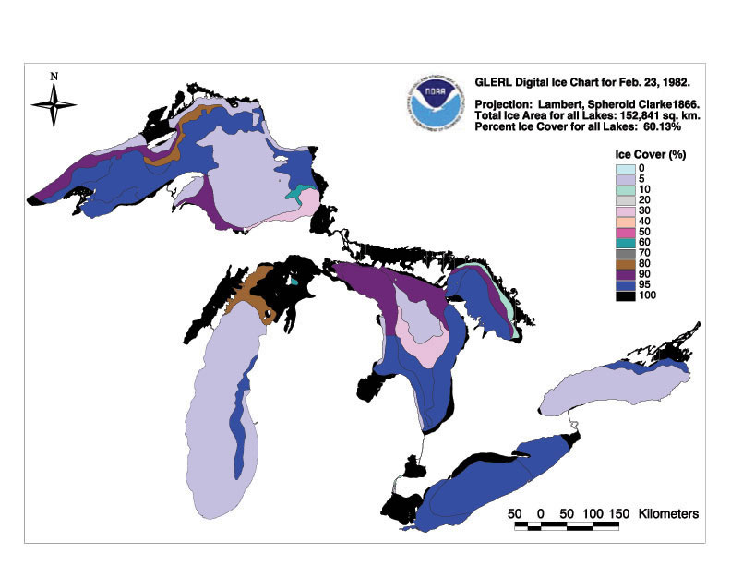
1982

Slide 29
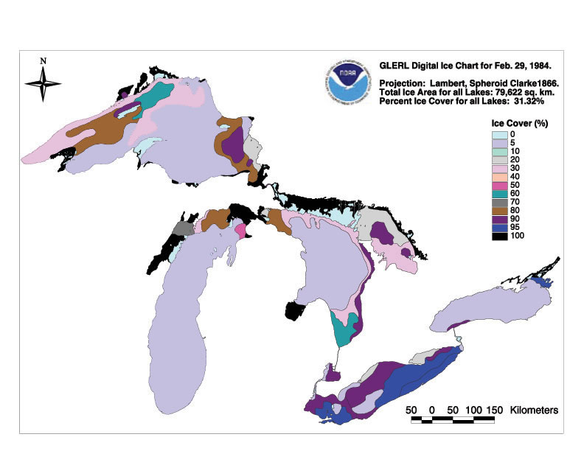
1984

Slide 30
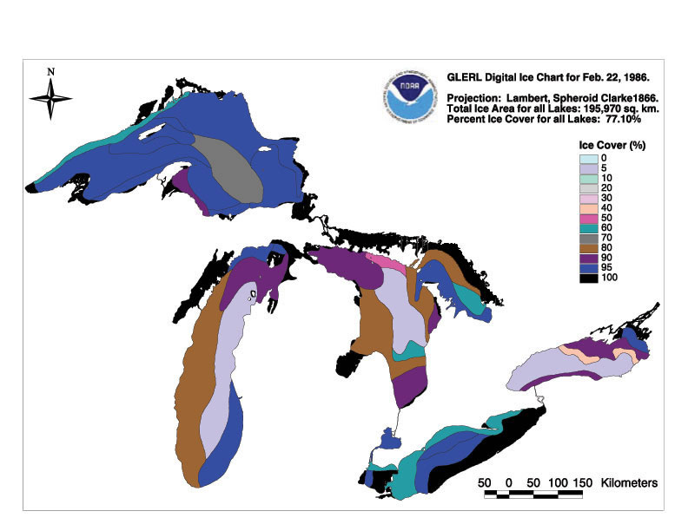
1986

Slide 31
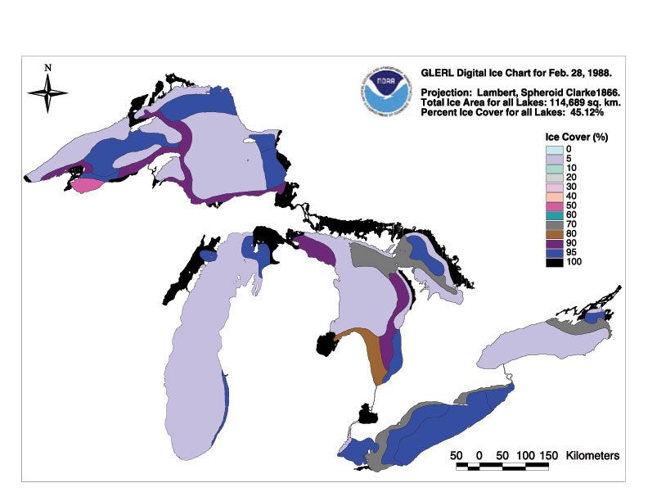
1988

Slide 32
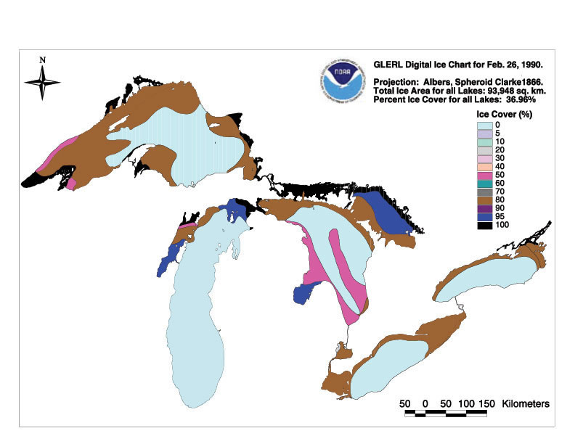
1990

Slide 33
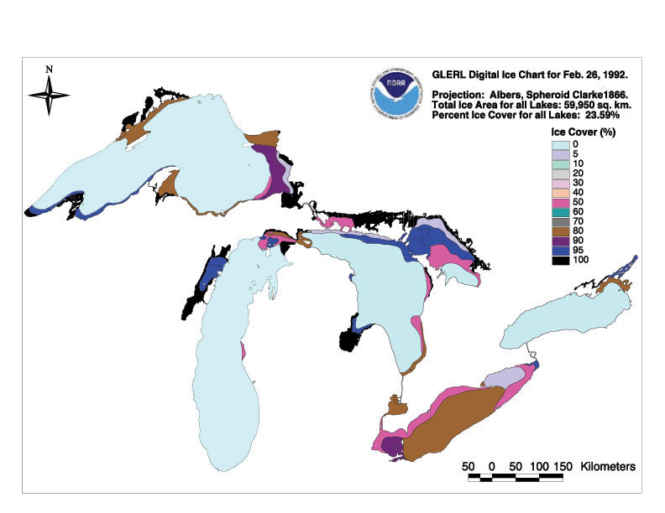
1992

Slide 34
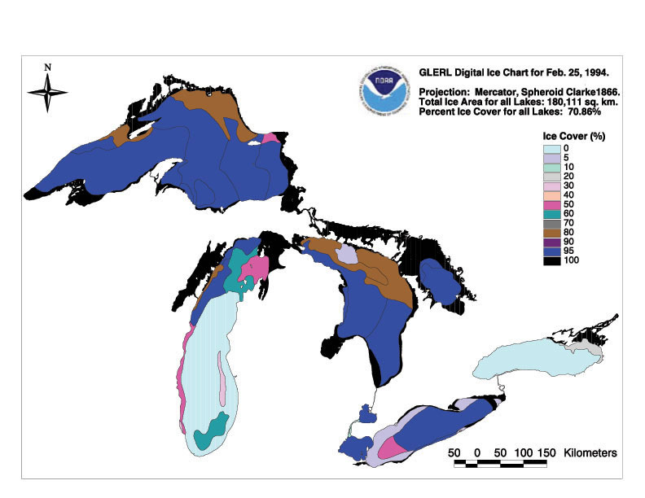
1994

Slide 35
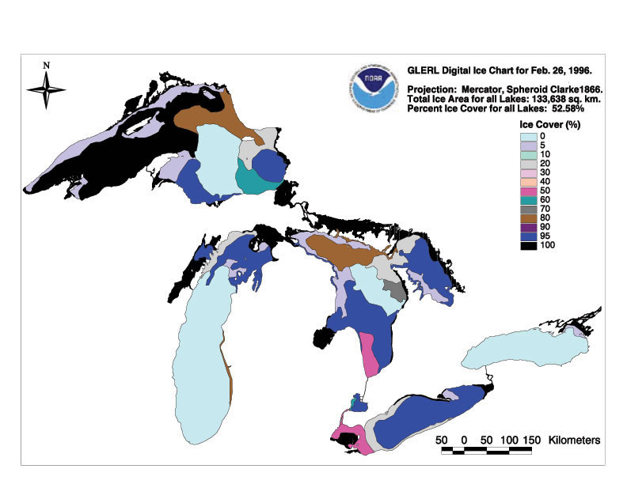
1996

Slide 36
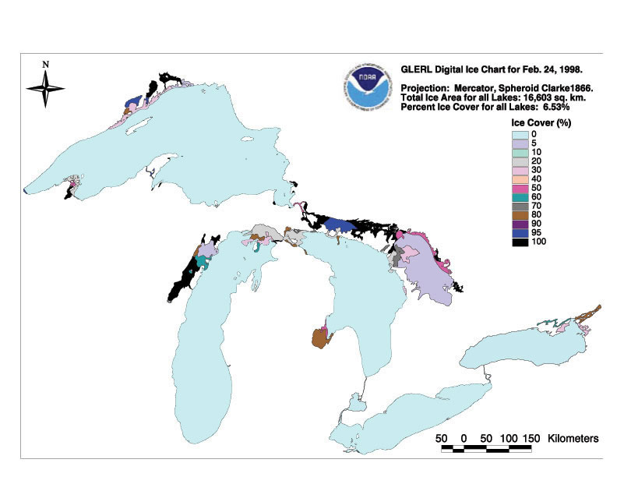
1998

Slide 37
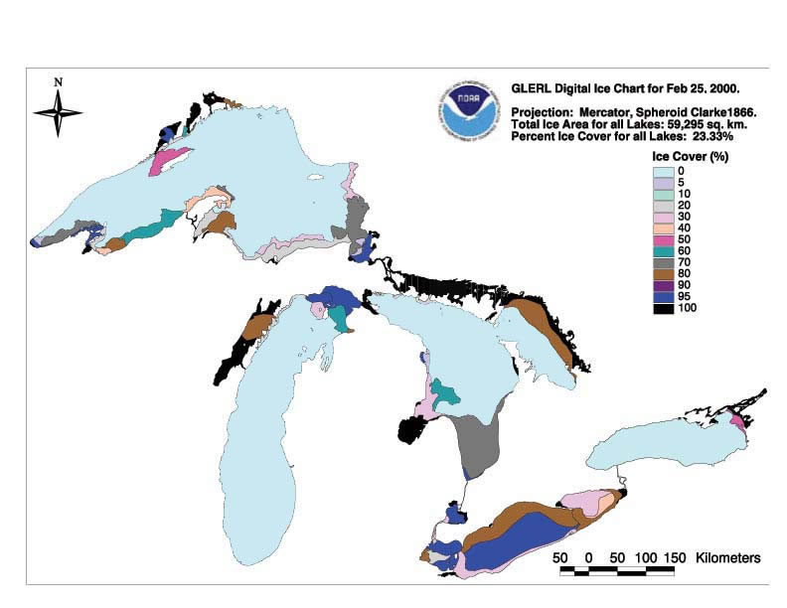
2000

Slide 38
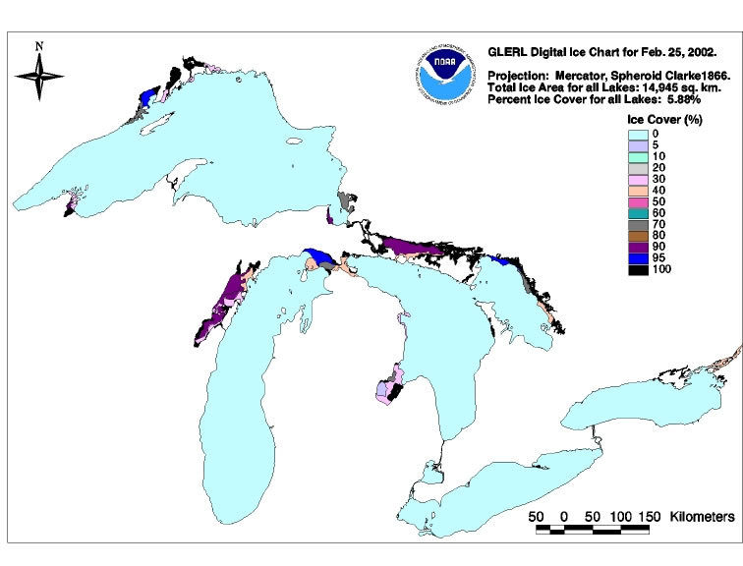
2002: essentially no ice in February

Slide 39
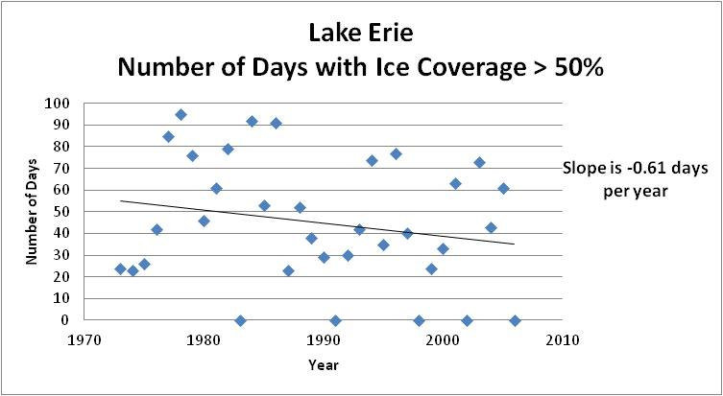
Lake Erie: Decreasing Ice coverage

Slide 40
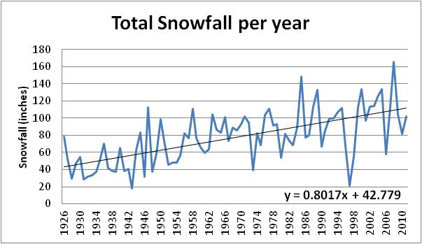
Snowfall in Erie over the past Century

Slide 41
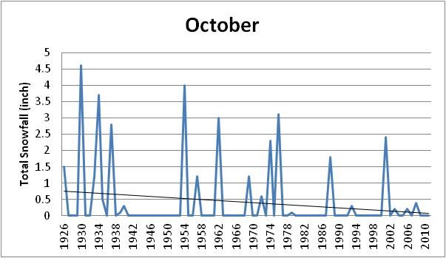
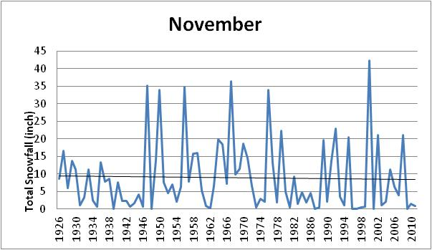
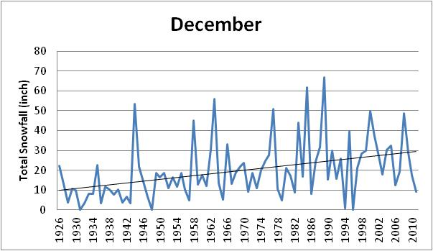
Snowfall during Fall

Slide 42
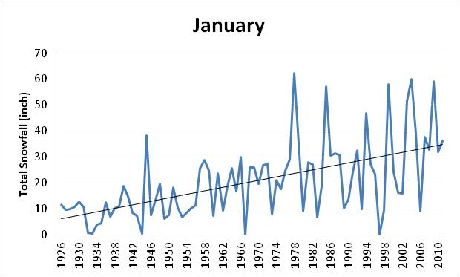
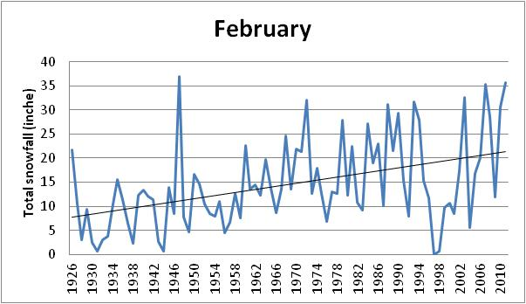
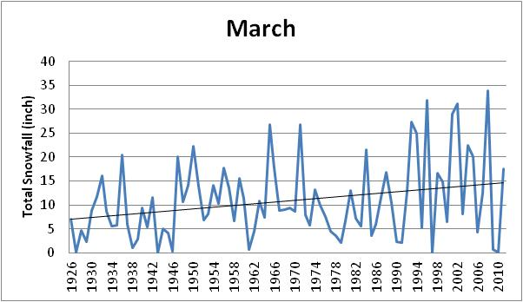
Snowfall winter/spring

Slide 43
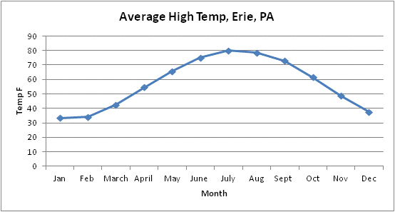
Temperature Patterns in Erie, PA Normally, the average high temperature does not reach 70 F until the end of May

Slide 44
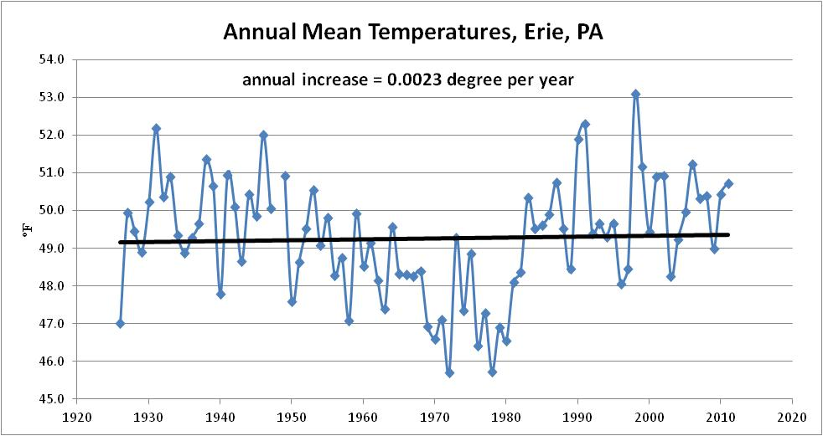
Annual Average Temperatures in Erie (last 85 years from official NWS data)

Slide 45
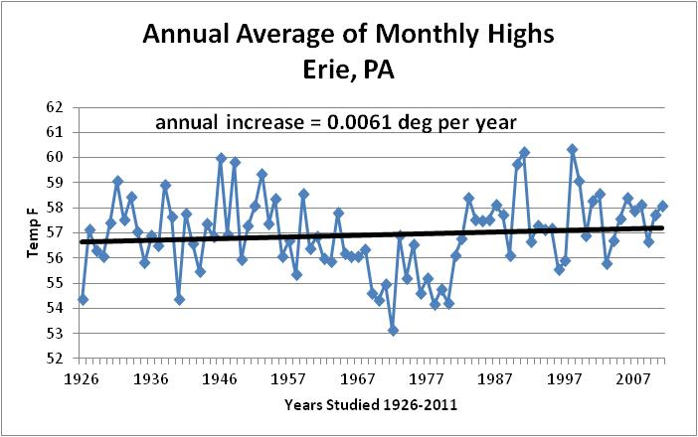
High Temperatures

Slide 46
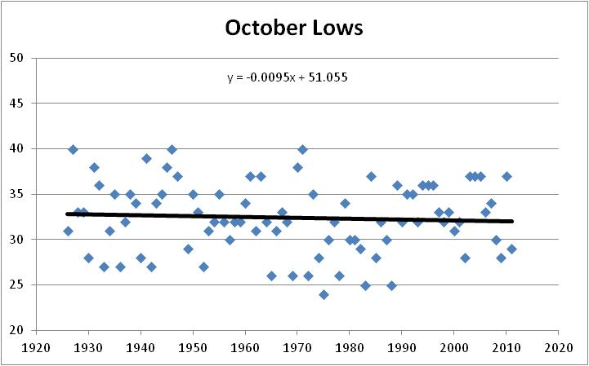
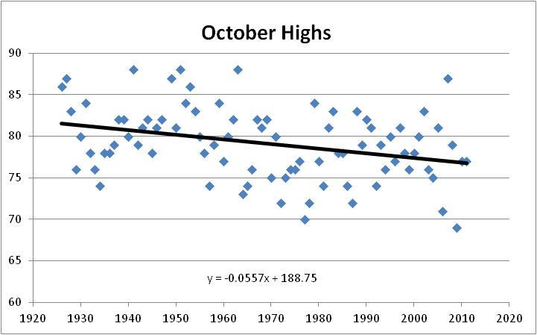
Fall Temperatures

Slide 47
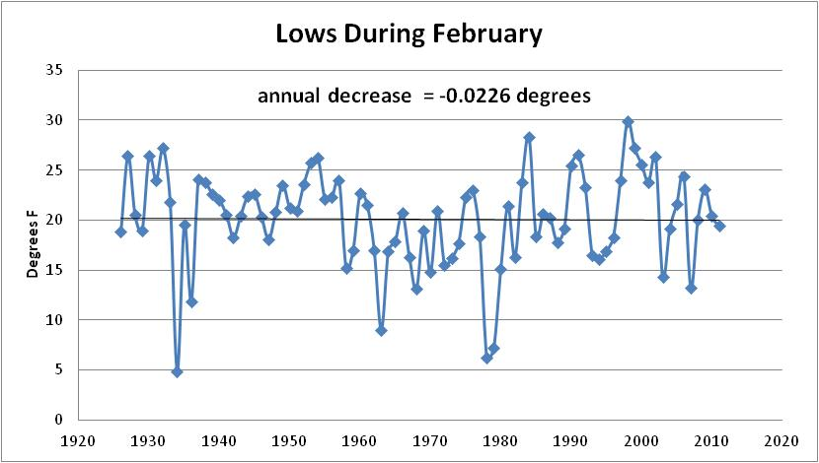
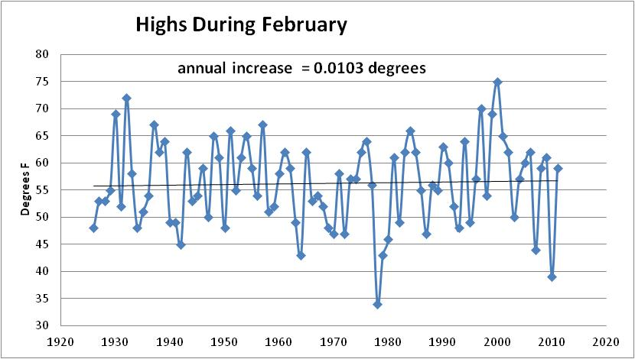
February in Erie

Slide 48
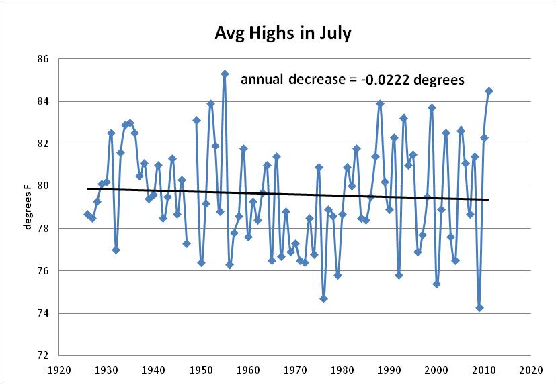
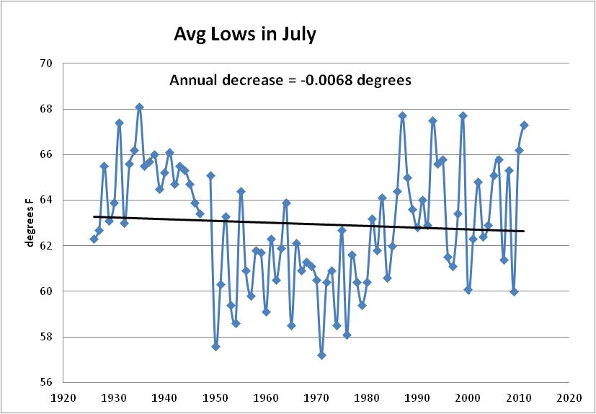
Summer in Erie

Slide 49
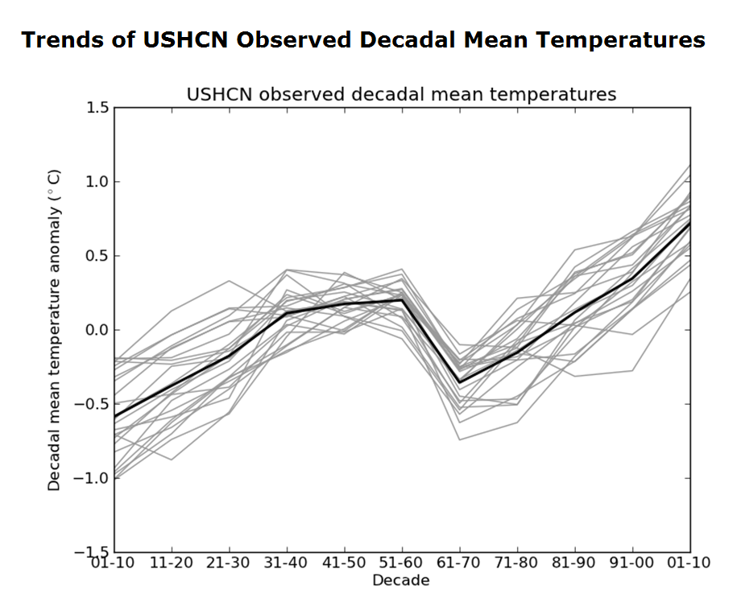
Temperature Trends across Pennsylvania source: PA State Climatology Office

Slide 50

NOAA website

Slide 51
NOAA website: signs of climate change

Slide 52

NOAA website: colder in Europe, warmer in the Arctic

Slide 53
So, what do you think is going on? Do we have anything to worry about? If so, what can or should be done?

Slide 54
Thanks for Listening!

